Slide 1
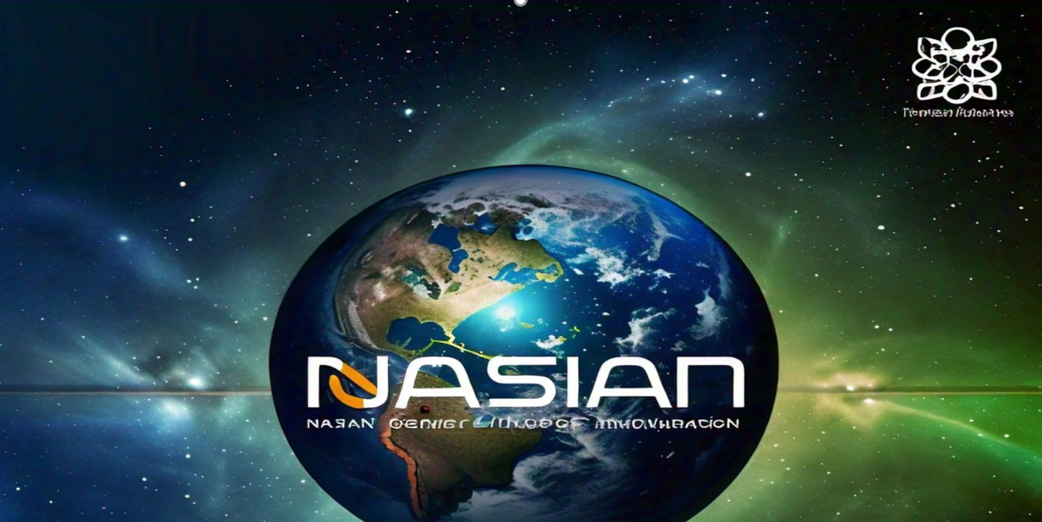


NGCI
M. Umer Farooq
Arfa Zahid
Aqsa Fiaz
Areeba Hanif
Hira Zahid
Ahmad Azhar
Nasian Gender-Climate Initiative NGCI
Pakistan

Slide 2

Intoduction
Challenge
Gender Inequality & Climate Change
United Nations Sustainable Development Goals (SDGs), established in 2015, aim to promote human development while protecting the environment.
Goal 5: Gender Equality
Goal 13: Climate Action highlight two critical global issues that, while often considered separately, are deeply interconnected.

Slide 3

Problem Statement & Challenges
Problem Statement
Climate change exacerbates gender inequality, disproportionately affecting women and marginalized gender groups. This interconnected crisis leads to increased vulnerability, economic disparity, and heightened risks of gender-based violence (GBV) in the wake of environmental disasters.
Key Challenges
Increased Vulnerability
Economic Disparities
Gender-Based Violence (GBV)
Limited Access to Resources
Underrepresentation in Decision-Making

Slide 4


Nasian Solution
Project Objectives
Goals of the NASIAN Initiative
  Model the relationship between climate change and gender inequality.
  Identify and address vulnerable regions.
  Promote gender-inclusive climate resilience.
Sol 1: Climate-Resilient Agriculture for Women
Sol 2: Gender-responsive disaster management policies
Sol 3: Technological tools for gender-climate data representation
NGCI: A Gender-Inclusive Approach
Content:
  Community-driven climate resilience programs.
  Gender-responsive climate policies.
  Data-driven decision-making for gender equality.

Slide 5

Call to Action
  Advocate for gender-responsive policies and climate adaptation.
  Collaborate with local communities to empower women and tackle gender inequality.
Summarize the importance of gender-inclusive climate solutions.
Encourage stakeholders to support the NGCI project.
Invite collaboration for global impact.

Slide 6

WHY NASIAN ?
The NASIAN team excels in tackling the intersection of gender and climate through innovative, data-driven solutions that empower marginalized communities. With a focus on collaboration and sustainable impact, NASIAN aligns its initiatives with the UN's SDGs to promote gender equality and climate resilience. Their expertise and global partnerships make them the ideal choice for driving meaningful change.

Slide 7


